Slide 1

HIGHCLOUD AIRLINES ANALYSIS
GROUP-4

Slide 2
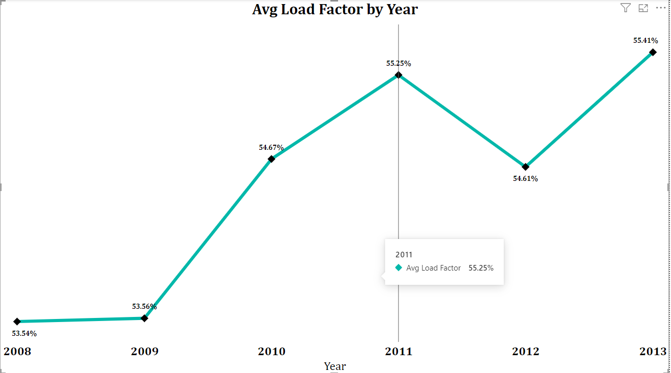
Yearly Avg Load Factor Percentage
Overall Growth: The average load factor shows an overall upward trend from 2008 to 2013, indicating improved efficiency in filling seats over the years.
Despite a slight dip in 2012, the load factor increased again in 2013, demonstrating resilience and effective adjustments.
The airline has managed to improve its load factor steadily from 2008 to 2011, indicating successful strategies in capacity management and demand stimulation.
2011 stands out as a peak year with the highest load factor of 55.25%. This indicates that the airline's operations and marketing strategies were particularly effective this year.

Slide 3
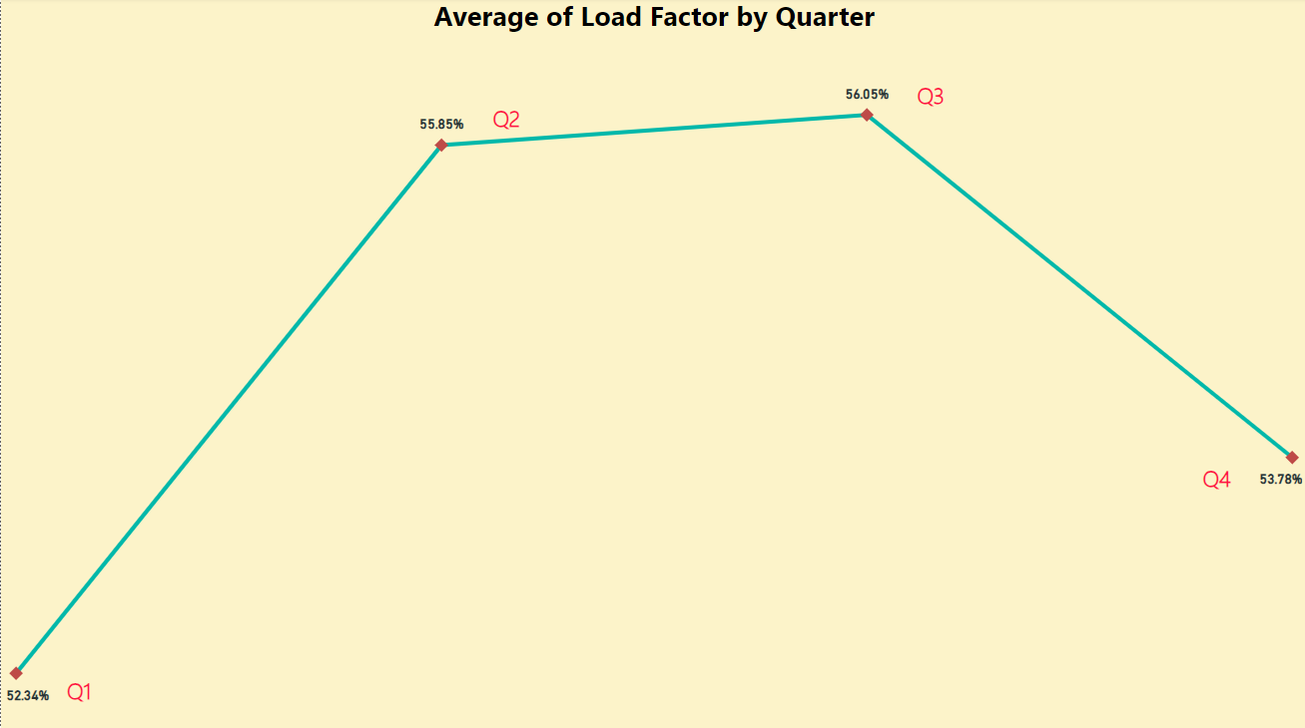
Quaterly Avg Load Factor Percentage
Q1: Generally shows lower load factors compared to other quarters, indicating possibly weaker demand or seasonal factors affecting the beginning of the year.
Q2: Slight improvement from Q1 but still relatively low compared to Q3 and Q4.
Q3: Consistently the highest load factor quarter across all years, suggesting peak travel season during this time.
Q4: Shows a drop from Q3 but still performs better than the first half of the year.

Slide 4
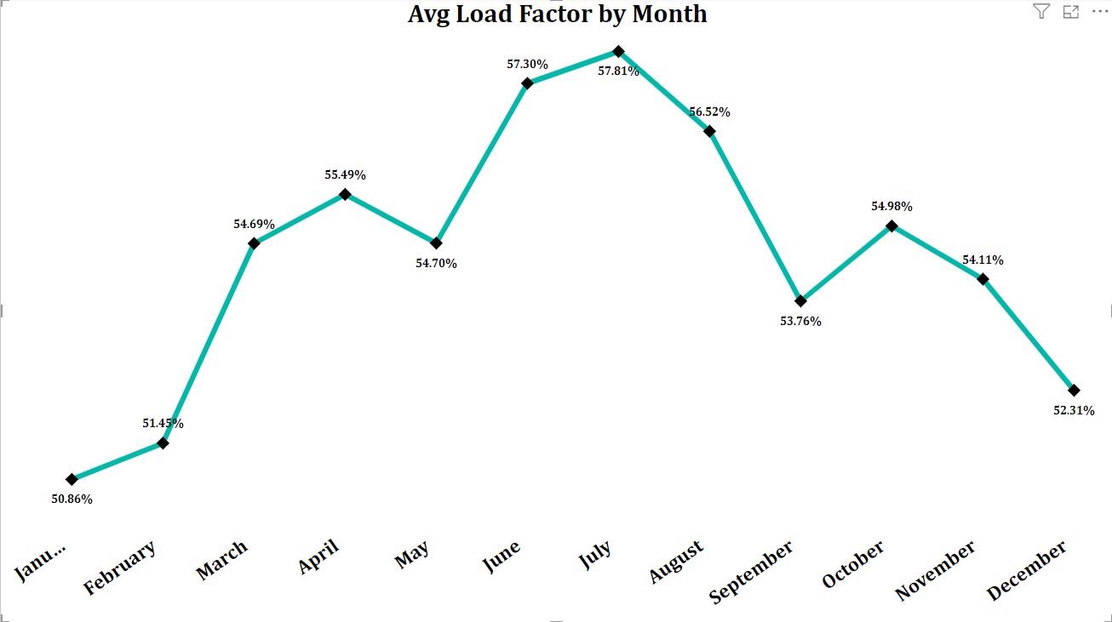
Avg Load Factor Percentage by Month
Winter (December - February): Lower average load factors, likely due to reduced travel demand after the holiday season.
Spring (March - May): Gradual increase in load factors, with April and May showing moderate improvement.
Summer (June - August): Highest load factors, indicating peak travel season.
Fall (September - November): A mix of moderate to low load factors, with a slight dip in September and a moderate increase in October and November.
Note : Here we can see a seasonal pattern

Slide 5
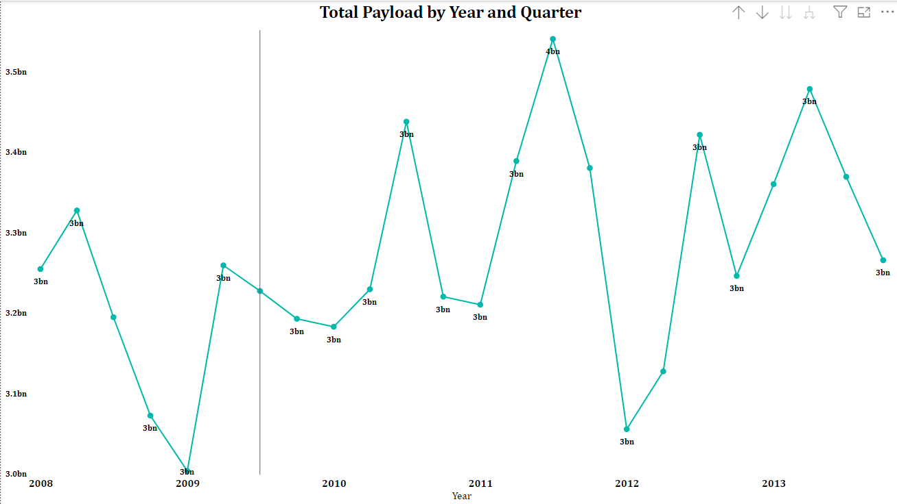
Yearly & Quarterly Payload
There are noticeable quarterly fluctuations in payload, indicating seasonal variations in demand. There are noticeable quarterly fluctuations in payload, indicating seasonal variations in demand.
Low Demand Quarters: (Q2 2009, Q1 2012): Sharp decline, possibly due to external factors affecting travel.
High Demand Quarters: (Q3 2011, Q4 2012, Q2 2013 ) Significant peak, indicating high demand during this period.
Recovery Trends : After each low period, there is typically a recovery in the following quarters, indicating resilience and adaptation to changing demand.

Slide 6
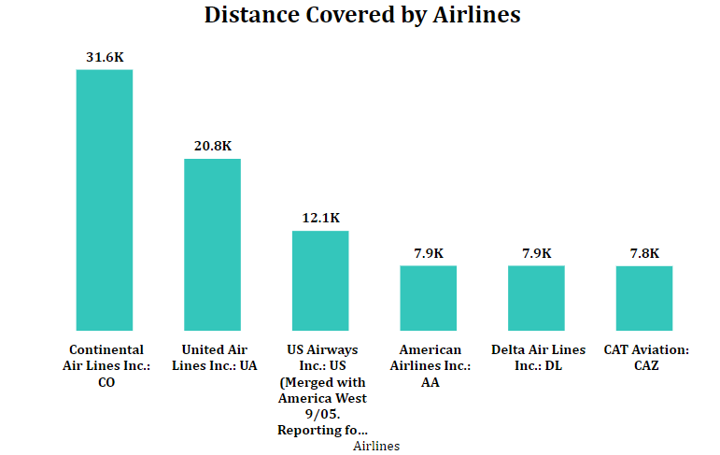
Distance travelled by Airlines.
From the data, it's evident that Continental Air Lines Inc. is the dominant airline in terms of distance traveled.
The total distance metric underscores the expansive reach of Highcloud Airlines, and mergers such as that of US Airways may affect future trends in distance metrics.
This could be due to its larger fleet size, higher number of routes, or more frequent flights.
The data also highlights significant contributors like CAT Aviation and Delta Air Lines, while other airlines play a smaller but still important role in the overall network.

Slide 7
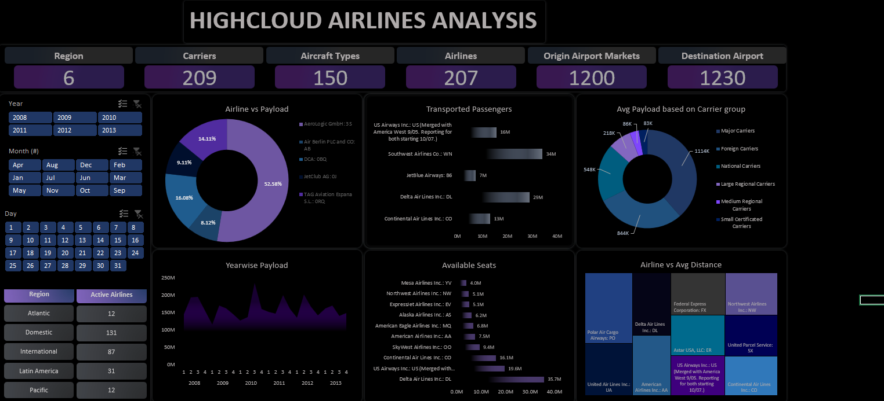

Slide 8
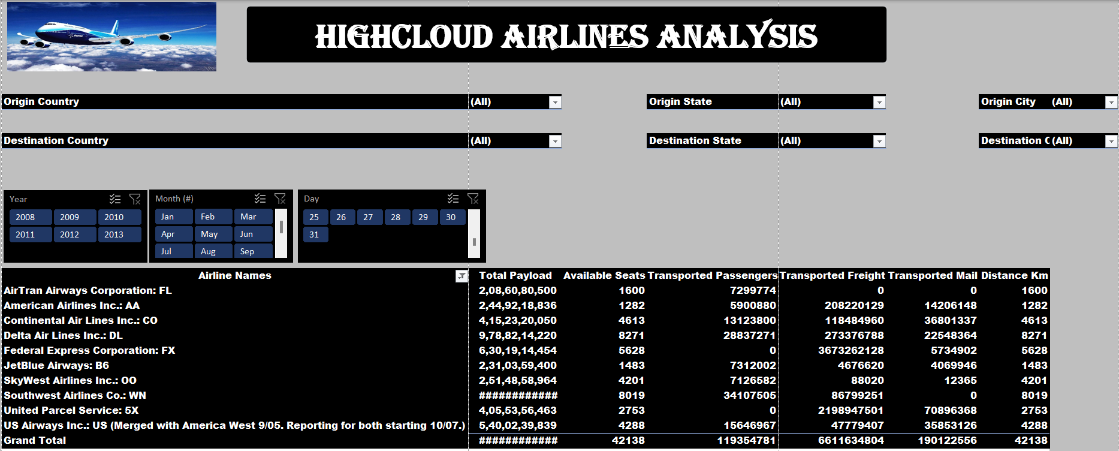

Slide 9
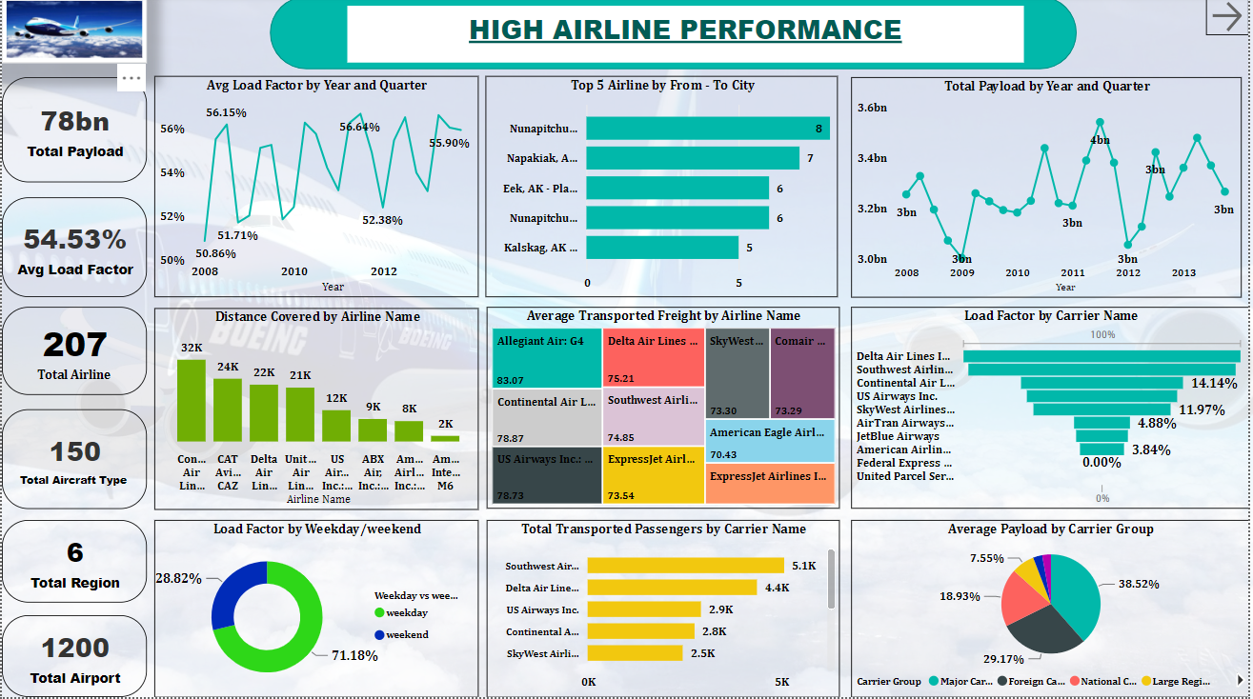

Slide 10
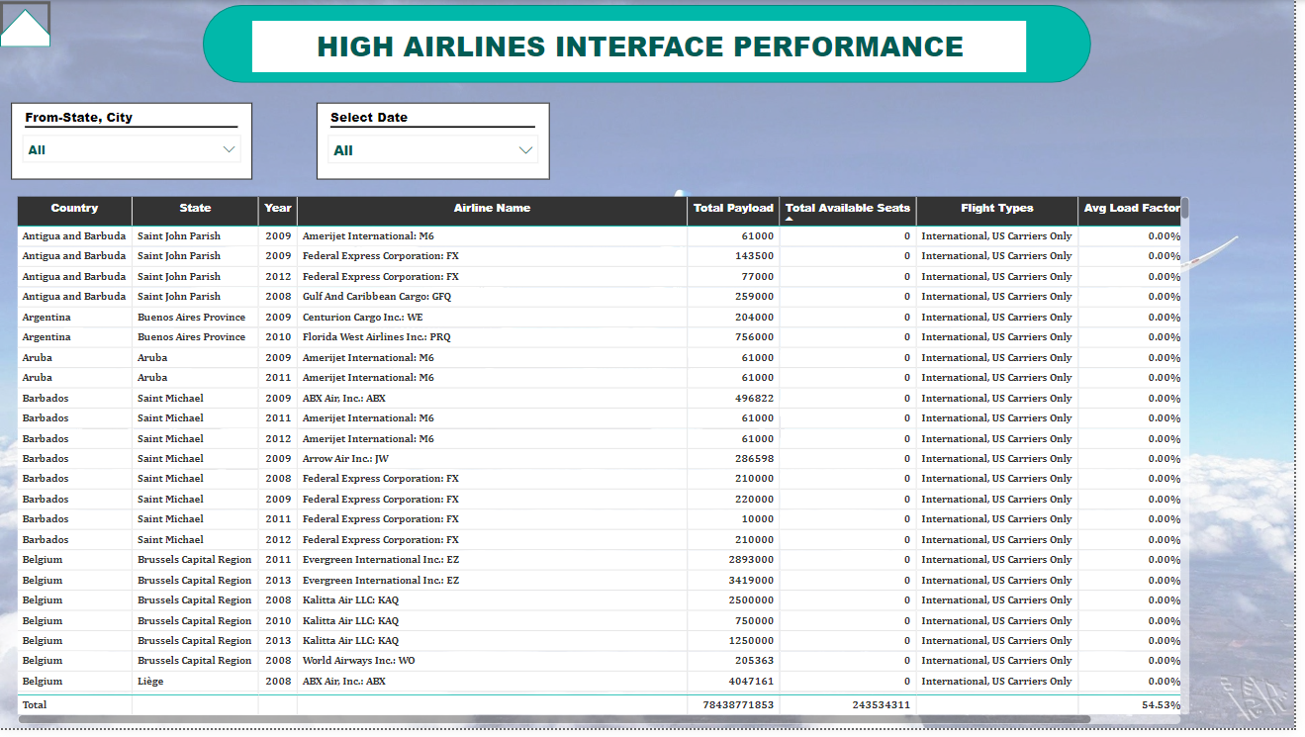

Slide 11
Your best quote that reflects your approach… “It’s one small step for man, one giant leap for mankind.”
- Neil Armstrong

